Slide 1
Chapter 12
Employee Benefits

Slide 2
Introduction
Employee Benefits
Have become important tools for recruiting and retention of qualified workers
Do not directly affect a worker’s performance, but inadequate benefits lead to employee dissatisfaction
Competition for the best employees required employers to offer creative benefit packages

Slide 3
Introduction
Benefit and service offerings add about 30% to an organization’s payroll cost
Benefits may become the focus of negotiations with employees when large wage and salary increases are not feasible
Some of the benefits we enjoy today were established under
Franklin Roosevelt’s New Deal as a response to the Great Depression--
most notably unemployment insurance and social security.
To get a taste of this extraordinary time, watch
http://www.youtube.com/watch?v=4F4yT0KAMyo

Slide 4
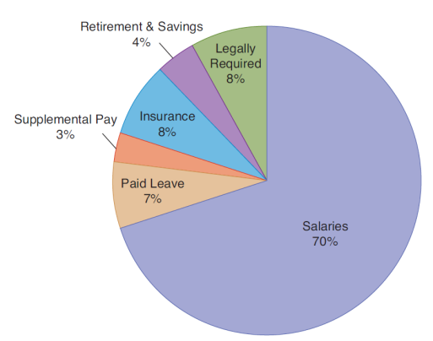
Introduction
Benefits are approximately 30% of total compensation

Slide 5
Legally Required Benefits
Social Security
Financed by equal employee and employer contributions, based on a percentage of earnings
Provides income for retirees, disabled workers and surviving dependents
Provides some health insurance coverage through Medicare
Social Security Administration website: Click here

Slide 6
Legally Required Benefits
Unemployment Compensation
Funded by employers who pay combined federal and state tax imposed on taxable wage base
Tax varies based on organization’s unemployment experience: the more layoffs, the higher the rate
Provides employees with some income continuation during periods of involuntary unemployment
Typical coverage is for 26 weeks
May be extended beyond 26 weeks when unemployment is high

Slide 7
Legally Required Benefits
Requirements to Receiving Unemployment Benefits:
Involuntary loss of job (but not having been fired)
Must have worked a minimum number of weeks
Have applied to a state agency for unemployment
Have registered for available work
Are willing to accept any suitable job offered through the state agency

Slide 8

Legally Required Benefits
Workers’ Compensation
Paid for by the organization
Rates based on likelihood of accidents, past history, and the type of industry
Benefits pay expenses and/or compensate for losses resulting from work-related accidents or illness, regardless of fault

Slide 9
Legally Required Benefits
Family and Medical Leave Act
Requires employers with 50 or more employees to allow up to 12 weeks of unpaid leave for family or medical reasons
Specifies record-keeping and communication requirements
Employer must maintain health benefits.
Chapter 3 contains detailed coverage of FMLA

Slide 10
Voluntary Benefits
Health Insurance
Increases in healthcare costs have made health insurance a critical benefit
Healthcare costs are growing faster than wages
Purpose is to protect employee from catastrophic loss should a serious illness occur
The Affordable Care Act survived a challenge in the Supreme Court in 2012 and is fully implemented in 2014 Click here to go to the implementation timeline at the Healthcare.gov site.

Slide 11




Voluntary Benefits
Traditional Health Insurance
Typically has the fewest coverage limitations for the employee
Usually the most expensive
Provides coverage in three areas:
Hospitalization
Medical/surgical
Major medical
Major insurers include:

Slide 12






Voluntary Benefits
Health Maintenance Organizations (HMOs)
Alternative benefit required by Health Maintenance Act of 1973
Broad comprehensive care provided by physicians who are “in network”
Employee incurs small co pay
Health care choices significantly limited
Major HMOs include:

Slide 13
Voluntary Benefits
Preferred Provider Organizations (PPOs)
Member health care providers agree to provide services at a fixed fee
Employees are encouraged by lower rates to use member or “preferred” providers
Combine best of HMOs and traditional insurance
Point-of-Service Plans (POS)
Require primary care physicians
Employee can go out of network, but pays up front and seeks reimbursement

Slide 14
Voluntary Benefits
Consumer-driven Health Plans
High deductible
Health savings account
Support services help employees make decisions
Employer-operated Coverage
Employers self-fund insurance programs
Operated under a voluntary employees beneficiary association (veba) to reduce costs
Often hire third party to administer

Slide 15
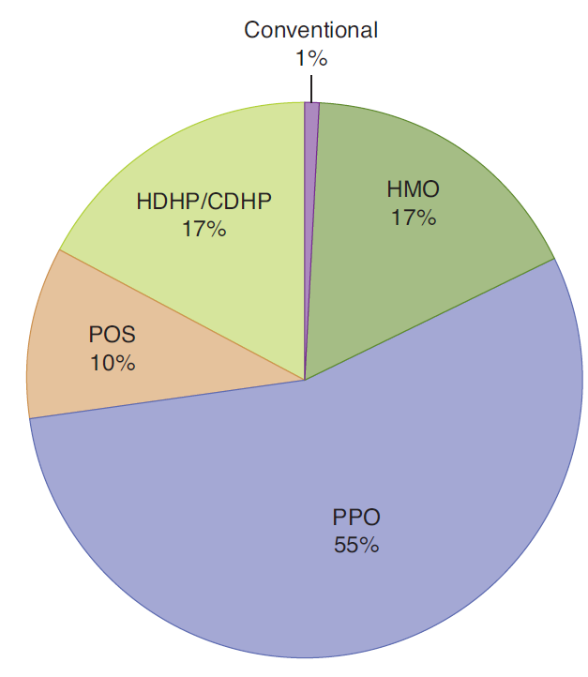
Which types of health plans are most commonly offered?

Slide 16
Voluntary Benefits
Health Insurance Continuation
The Consolidated Omnibus Budget Reconciliation Act (COBRA)
Provides for continuation of benefits for up to three years after an employee leaves a job
Cost is paid by the employee

Slide 17

Voluntary Benefits
The HIPAA Requirement
The Health Insurance Portability and Accountability Act of 1996
Imposed on employers and health providers regulations regarding the confidentiality of employee health information
Click here for more information from the U.S. Department of Health and Human Services

Slide 18
Patient Protection and Affordable Care Act expands availability and regulation of health insurance. Includes:
Individual responsibility
Individuals must purchase minimum coverage or pay fine
Health Insurance Exchanges
Created by states for individuals and small businesses to buy insurance
Employer responsibility
Penalties for employers with over 50 employees who do not provide coverage
Employers with more than 200 employees must provide coverage
Penalties for coverage that is inadequate or too expensive
Insurance Industry responsibility
Ends restrictions on pre-existing coverage and lifetime limits
Must provide coverage for employee's children up to age 26

Slide 19
Retirement Benefits
Employee Retirement Income Security Act (ERISA) of 1974
Vesting rights – right to pension benefits even if one leaves the company
Enables pension rights to be portable
Sets up pension benefit guaranty corporation (PBGC)
Claims corporate assets to cover inadequately funded pension plans
Requires summary plan description (SPD)

Slide 20
Retirement Benefits
Defined Benefit Plans
Plan specifies the dollar benefit workers receive at retirement
Usually based on some formula of years of service and average final compensation
More common in government and unionized industries

Slide 21
Retirement Benefits
Defined Contribution Plans
Employee and employer may contribute to account based on rules established for contributions
Amount of benefits depends on success of account investments
money purchase
pension plans
profit-sharing
plans
IRAs
401Ks

Slide 22
Retirement Benefits
Money Purchase Pension Plan
Type of defined contribution plan
Organization commits to depositing fixed amount of money or percentage of employee’s pay annually
Profit-Sharing Plans
Variation of defined contribution plan
Company amount contributed depends on profit level in the organization
Contribution is optional, not required
Individual Retirement Accounts (IRAs)
Employer makes contributions
Can defer taxes on amount deposited and interest earned in retirement account
Two types exist for small businesses and self-employed
401(k)s:
Permit workers to set aside specified amount of income on tax-deferred basis
Employers may match employee contribution

Slide 23

Paid Time Off
Vacation and Holiday Leave
Vacation time is usually related to the length of time on the job
Some companies also allow personal days that can be used for any reason

Slide 24
Paid Time Off
Disability Insurance Programs
Provides salary continuation for:
Short-term disabilities (sick leave)
Long-term disabilities (coverage usually effective after 6 months)
Some companies provide financial incentives to employees to not use their sick leave
Long-term disability plans usually replace a portion of the employee’s salary, often 60%

Slide 25
Survivor Benefits
Group Term Life Insurance
Benefit is usually based on one’s annual rate of pay
Supplemental insurance increases coverage to two to five-times the employee’s salary
Travel Insurance
Life insurance for business travel-related deaths (not including normal commuting)

Slide 26
Employee Services
The Service Side of Benefits:
Employers often can provide services at no cost or at a significant reduction from the usual cost. May include:
Employee assistance programs
Credit unions
Housing
Tuition reimbursement
Uniforms
Company-paid transportation
Social and recreational events
Parking

Slide 27
An Integrative Perspective on Employee Benefits
Flexible Spending Accounts
Employees set aside money for expenses not covered by insurance
Modular Plans
Employees may choose from pre-determined benefit packages
Core-Plus Options
Employees may select benefits to add to core benefit package

Slide 28
An Integrative Perspective on Employee Benefits
Flexible Spending Accounts
Under Section I25 of the Internal Revenue Code employees can set aside a designated dollar amount before taxes for specified services such as
Health-care premiums
Medical expenses
Dependent child or elder care
Group legal services
IRS requires that accounts for different purposes be separate and that all money be spent during the year or forfeited
Not subject to federal, state, and social security taxes

Slide 29
An Integrative Perspective on Employee Benefits
Modular Plans
Employees choose a pre-designed package of benefits from several options
Core-Plus Options Plans
Employees given core coverage (e.g. medical, life, disability) with option to select other benefits

Slide 30
Let’s Play Jeopardy-style!
1. Social Security, unemployment compensation, workers’ compensation, FMLA.
What are legally required benefits?
2. Benefits that pay expenses and/or compensate for losses resulting from work-related accidents or illness, regardless of fault.
What is workers’ compensation?
3. Health insurance, retirement plans, time off, disability, life insurance.
What are voluntary benefits?
4. Requires employers with 50 or more employees to allow up to 12 weeks of unpaid leave for family or medical reasons.
What is the Family Medical Leave Act?
5. Money purchase pension plans, profit-sharing plans, IRAs, 401Ks.
What are defined contribution plans?
6. Flexible spending accounts, modular plans, core-plus plans.
What are flexible benefits?

